Slide 1
Discrete Mathematics combinations, inverse binomial transform, distributing objects into boxes
Liangfeng Zhang
School of Information Science and Technology
ShanghaiTech University

Slide 2
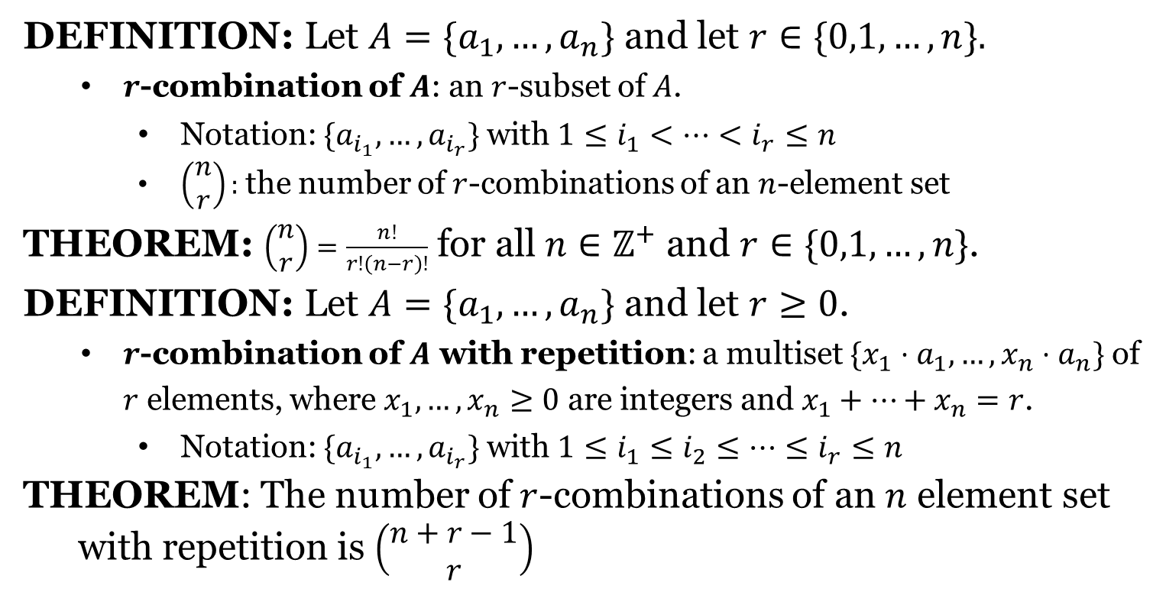
Combinations of Sets
DEFINITION: Let $A=\{a_{1},…,a_{n}\}$ and let $r∈\{0,1,…,n\}.$
$r$-combination of $A$: an $r$-subset of $A$.
Notation: $\{a_{i_{1}},…,a_{i_{r}}\}$ with $1≤i_{1}<⋯<i_{r}≤n$
$\left(\begin{aligned}n \\ r\end{aligned}\right):$ the number of $r$-combinations of an $n$-element set
THEOREM: $\left(\begin{aligned}n \\ r\end{aligned}\right)=\frac{n!}{r!\left(n−r\right)!}$ for all $n∈ℤ^{+}$ and $r∈\{0,1,…,n\}$.
DEFINITION: Let $A=\{a_{1},…,a_{n}\}$ and let $r≥0$.
$r$-combination of $A$ with repetition: a multiset $\{x_{1}⋅a_{1},…,x_{n}⋅a_{n}\}$ of $r$ elements, where $x_{1},…,x_{n}≥0$ are integers and $x_{1}+⋯+x_{n}=r$.
Notation: $\{a_{i_{1}},…,a_{i_{r}}\}$ with $1≤i_{1}≤i_{2}≤…≤i_{r}≤n$
THEOREM: The number of $r$-combinations of an $n$ element set
with repetition is $\left(\begin{aligned}n+r−1 \\ r\end{aligned}\right)$

Slide 3
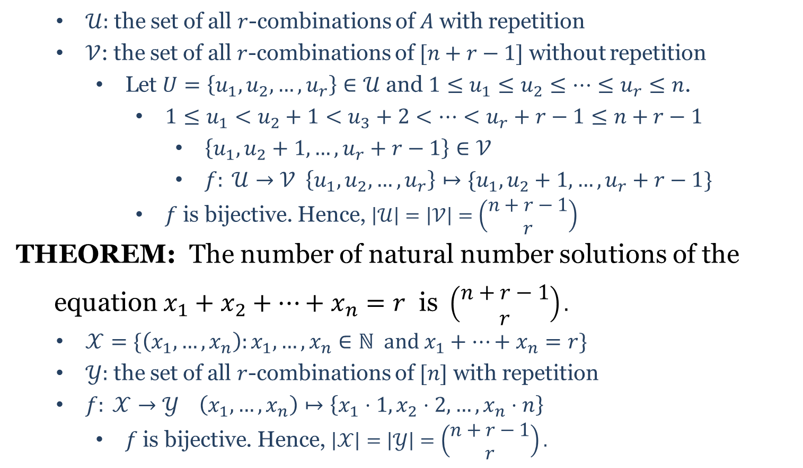
Combinations of Sets
$𝒰:$ the set of all $r$-combinations of $A$ with repetition
$𝒱$: the set of all $r$-combinations of $[n+r−1]$ without repetition
Let $U=\left\{u_{1},u_{2},…,u_{r}\right\}∈𝒰$ and $1≤u_{1}≤u_{2}≤⋯≤u_{r}≤n$.
$1≤u_{1}<u_{2}+1<u_{3}+2<⋯<u_{r}+r−1≤n+r−1$
$\left\{u_{1},u_{2}+1,…,u_{r}+r−1\right\}∈𝒱$
$f: 𝒰→𝒱 \left\{u_{1},u_{2},…,u_{r}\right\}↦\{u_{1},u_{2}+1,…,u_{r}+r−1\}$
$f$ is bijective. Hence, $\left|𝒰\right|=\left|𝒱\right|=\left(\begin{aligned}n+r−1 \\ r\end{aligned}\right)$
THEOREM: The number of natural number solutions of the
equation $x_{1}+x_{2}+⋯+x_{n}=r$ is $\left(\begin{aligned}n+r−1 \\ r\end{aligned}\right).$
$𝒳=\{\left(x_{1},…,x_{n}\right):x_{1},…,x_{n}∈ℕ and x_{1}+⋯+x_{n}=r\}$
$𝒴:$ the set of all $r$-combinations of $[n]$ with repetition
$f: 𝒳→𝒴 \left(x_{1},…,x_{n}\right)↦\left\{x_{1}⋅1, x_{2}⋅2, …, x_{n}⋅n\right\}$
$f \text{is} \text{bijective}$. Hence, $\left|𝒳\right|=\left|𝒴\right|=\left(\begin{aligned}n+r−1 \\ r\end{aligned}\right).$

Slide 4
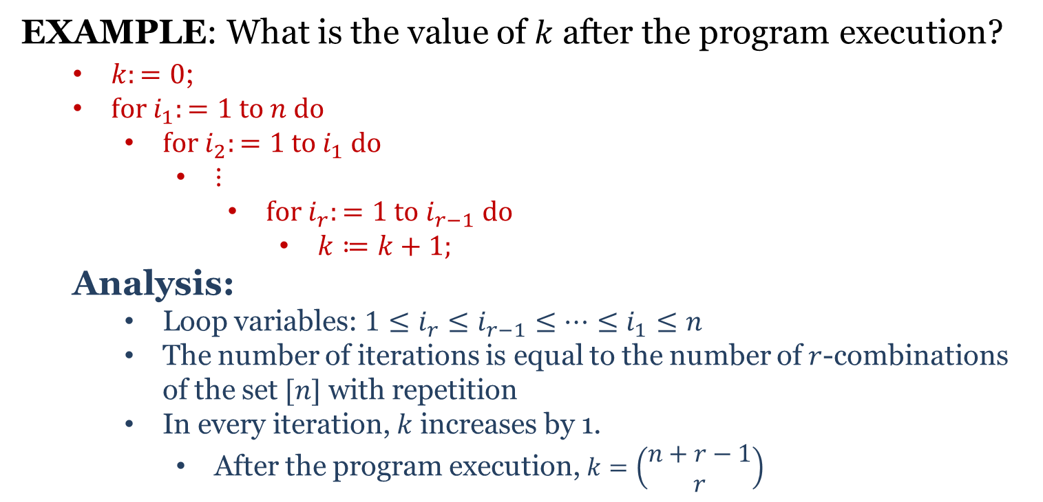
Application
EXAMPLE: What is the value of $k$ after the program execution?
$k:=0$;
$for i_{1}:=1 to n do$
$for i_{2}:=1 to i_{1} do$
⋮
$for i_{r}:=1 to i_{r−1} do$
$k≔k+1;$
Analysis:
Loop variables: $1≤i_{r}≤i_{r−1}≤⋯≤i_{1}≤n$
The number of iterations is equal to the number of $r$-combinations of the set $[n]$ with repetition
In every iteration, $k$ increases by 1.
After the program execution, $k=\left(\begin{aligned}n+r−1 \\ r\end{aligned}\right)$

Slide 5
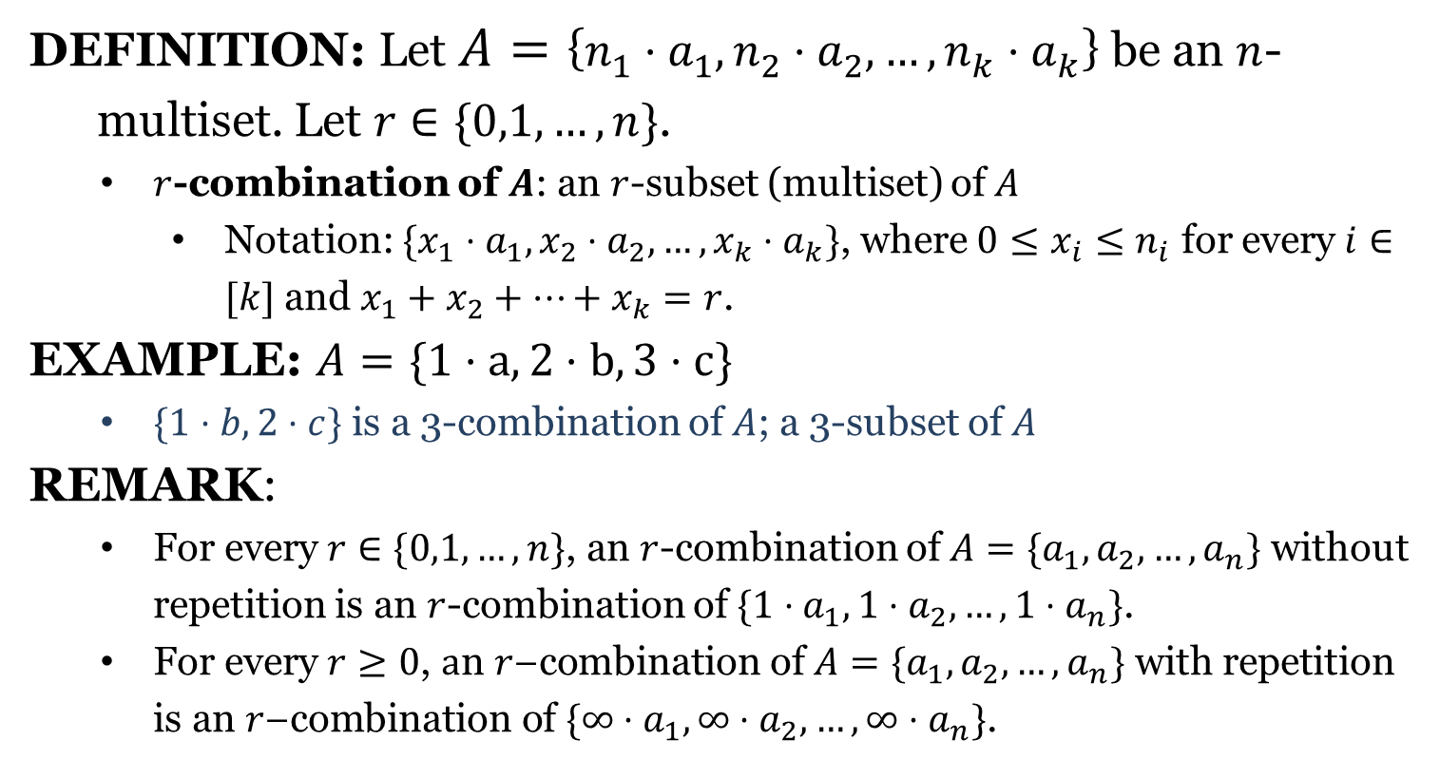
Combinations of Multiset
DEFINITION: Let $A=\left\{n_{1}⋅a_{1}, n_{2}⋅a_{2},…,n_{k}⋅a_{k}\right\}$ be an $n$-
multiset. Let $r∈\{0,1,…,n\}$.
$r$-combination of $A$: an $r$-subset (multiset) of $A$
Notation: $\{x_{1}⋅a_{1},x_{2}⋅a_{2},…,x_{k}⋅a_{k}\}$, where $0≤x_{i}≤n_{i}$ for every $i∈[k]$ and $x_{1}+x_{2}+⋯+x_{k}=r$.
EXAMPLE: $A=\{1⋅a, 2⋅b, 3⋅c\}$
$\{1⋅b,2⋅c\}$ is a 3-combination of $A$; a 3-subset of $A$
REMARK:
For every $r∈\{0,1,…,n\}$, an $r$-combination of $A=\{a_{1},a_{2},…,a_{n}\}$ without repetition is an $r$-combination of $\{1⋅a_{1},1⋅a_{2},…,1⋅a_{n}\}$.
For every $r≥0$, $a\text{n} r\text{−}\text{combination} \text{of} A=\{a_{1},a_{2},…,a_{n}\} \text{with} \text{repetition} \text{is} \text{an} r\text{−}\text{combination} \text{of} \{∞⋅a_{1},∞⋅a_{2},…,∞⋅a_{n}\}\text{.}$

Slide 7
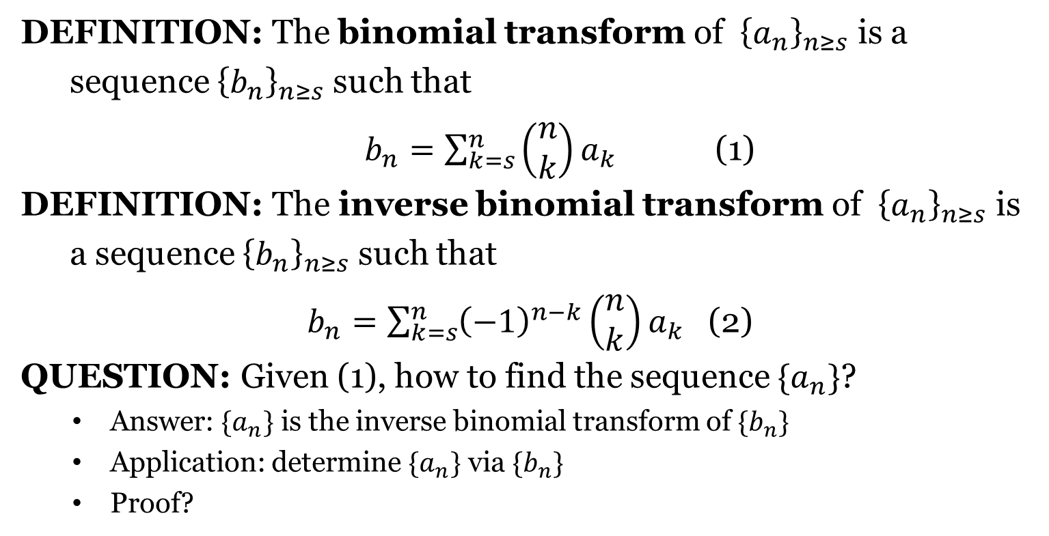
Inverse Binomial Transform
DEFINITION: The binomial transform of ${\left\{a_{n}\right\}}_{n≥s}$ is a
sequence ${\left\{b_{n}\right\}}_{n≥s}$ such that
$b_{n}=\sum_{k=s}^{n}{\left(\begin{aligned}n \\ k\end{aligned}\right)a_{k}}$ (1)
DEFINITION: The inverse binomial transform of ${\left\{a_{n}\right\}}_{n≥s}$ is
a sequence ${\left\{b_{n}\right\}}_{n≥s}$ such that
$b_{n}=\sum_{k=s}^{n}{{\left(−1\right)}^{n−k}\left(\begin{aligned}n \\ k\end{aligned}\right)a_{k}}$ (2)
QUESTION: Given (1), how to find the sequence $\{a_{n}\}$?
Answer: $\{a_{n}\}$ is the inverse binomial transform of $\{b_{n}\}$
Application: determine $\{a_{n}\}$ via $\{b_{n}\}$
Proof?

Slide 8
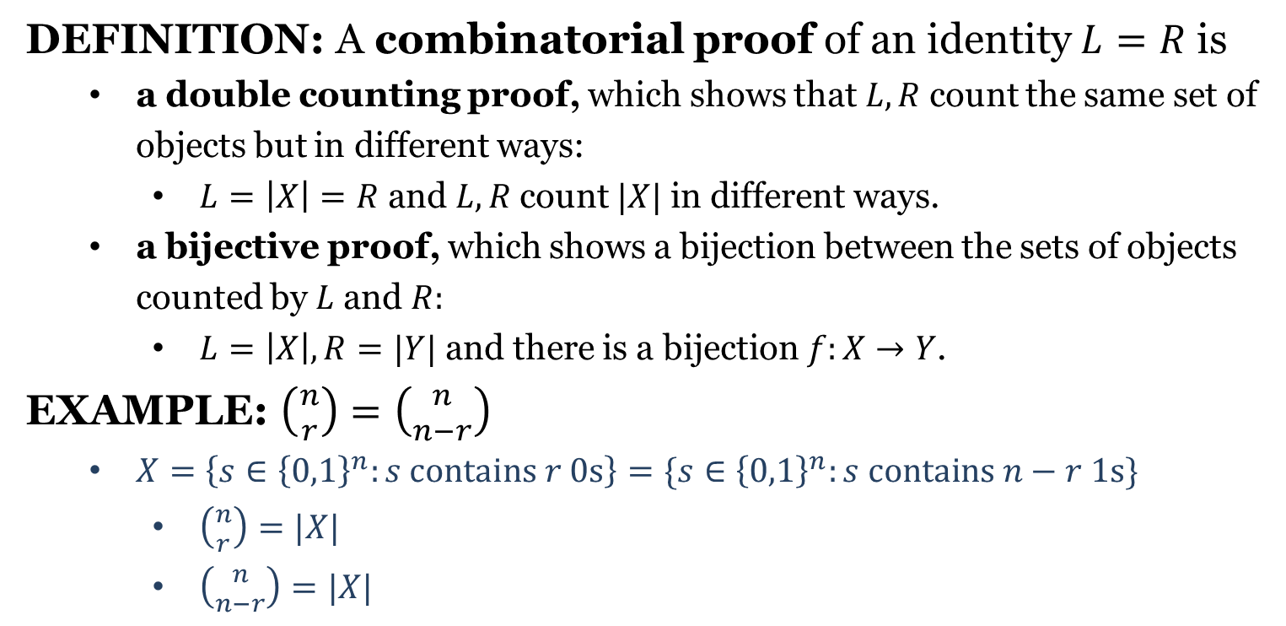
Combinatorial Proofs
DEFINITION: A combinatorial proof of an identity $L=R$ is
a double counting proof, which shows that $L,R$ count the same set of objects but in different ways:
$L=\left|X\right|=R$ and $L,R$ count $|X|$ in different ways.
a bijective proof, which shows a bijection between the sets of objects counted by $L$ and $R:$
$L=\left|X\right|, R=|Y|$ and there is a bijection $f:X→Y$.
EXAMPLE: $\left({n \atop r}\right)=\left({n \atop n−r}\right)$
$X=\left\{s∈{\left\{0,1\right\}}^{n}:s contains r 0s\right\}=\{s∈{\left\{0,1\right\}}^{n}:s contains n−r 1s\}$
$\left({n \atop r}\right)=|X|$
$\left({n \atop n−r}\right)=|X|$

Slide 9
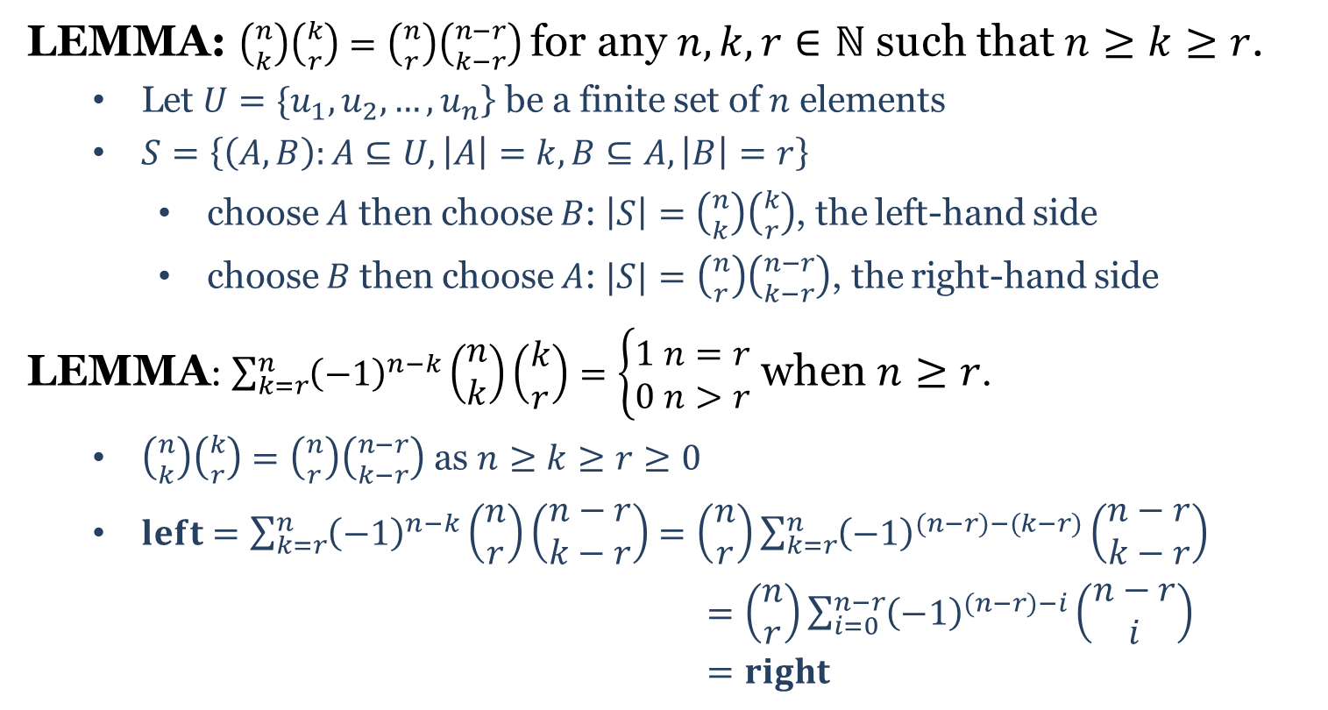
Inverse Binomial Transform
LEMMA: $\left({n \atop k}\right)\left({k \atop r}\right)=\left({n \atop r}\right)\left({n−r \atop k−r}\right)$ for any $n,k,r∈ℕ$ such that $n≥k≥r$.
Let $U=\{u_{1},u_{2},…,u_{n}$} be a finite set of $n$ elements
$S=\left\{\left(A,B\right):A⊆U,\left|A\right|=k,B⊆A,\left|B\right|=r\right\}$
choose $A$ then choose $B$: $\left|S\right|=\left({n \atop k}\right)\left({k \atop r}\right)$, the left-hand side
choose $B$ then choose $A$: $|S|=\left({n \atop r}\right)\left({n−r \atop k−r}\right)$, the right-hand side
LEMMA: $\sum_{k=r}^{n}{{\left(−1\right)}^{n−k}\left(\begin{aligned}n \\ k\end{aligned}\right)\left(\begin{aligned}k \\ r\end{aligned}\right)=\left\{\begin{aligned}1 n=r \\ 0 n>r\end{aligned}\right.}$ when $n≥r$.
$\left({n \atop k}\right)\left({k \atop r}\right)=\left({n \atop r}\right)\left({n−r \atop k−r}\right)$ as $n≥k≥r≥0$
$left=\sum_{k=r}^{n}{{\left(−1\right)}^{n−k}\left(\begin{aligned}n \\ r\end{aligned}\right)\left(\begin{aligned}n−r \\ k−r\end{aligned}\right)}$ $=\left(\begin{aligned}n \\ r\end{aligned}\right)\sum_{k=r}^{n}{{\left(−1\right)}^{(n−r)−(k−r)}\left(\begin{aligned}n−r \\ k−r\end{aligned}\right)}$
$=\left(\begin{aligned}n \\ r\end{aligned}\right)\sum_{i=0}^{n−r}{{\left(−1\right)}^{(n−r)−i}\left(\begin{aligned}n−r \\ i\end{aligned}\right)}$
$=right$

Slide 10




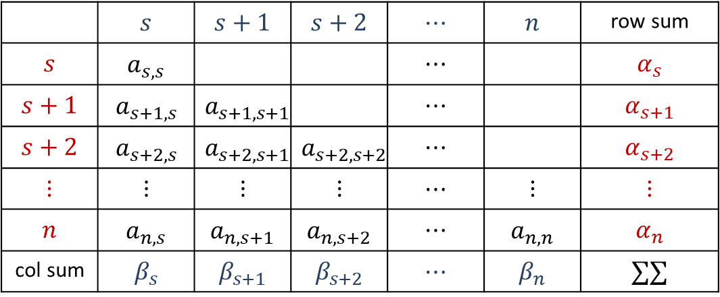

Inverse Binomial Transform
LEMMA: Let $n,s∈ℕ,s≤n.$ Then $\sum_{k=s}^{n}{\sum_{i=s}^{k}{a_{k,i}}}=\sum_{i=s}^{n}{\sum_{k=i}^{n}{a_{k,i}}}$
THEOREM: Let $\left\{a_{n}\right\}, \{b_{n}\}$ be two sequences s.t. for all $n≥s,$
$a_{n}=\sum_{k=s}^{n}{\left(\begin{aligned}n \\ k\end{aligned}\right)b_{k}}$. Then $b_{n}=\sum_{k=s}^{n}{{\left(−1\right)}^{n−k}\left(\begin{aligned}n \\ k\end{aligned}\right)a_{k}} (n≥s).$
$\sum_{k=s}^{n}{{\left(−1\right)}^{n−k}\left(\begin{aligned}n \\ k\end{aligned}\right)a_{k}}=\sum_{k=s}^{n}{{\left(−1\right)}^{n−k}\left(\begin{aligned}n \\ k\end{aligned}\right)\sum_{i=s}^{k}{\left(\begin{aligned}k \\ i\end{aligned}\right)b_{i}}}$
$=\sum_{i=s}^{n}{\sum_{k=i}^{n}{{\left(−1\right)}^{n−k}\left(\begin{aligned}n \\ k\end{aligned}\right)\left(\begin{aligned}k \\ i\end{aligned}\right)}b_{i}}=b_{n}$
$$α_{k}$$
$$β_{i}$$
 | $$s$$ | $$s+1$$ | $$s+2$$ | $$⋯$$ | $$n$$ | row sum
$$s$$ | $$a_{s,s}$$ |  |  | $$⋯$$ |  | $$α_{s}$$
$$s+1$$ | $$a_{s+1,s}$$ | $$a_{s+1,s+1}$$ |  | $$⋯$$ |  | $$α_{s+1}$$
$$s+2$$ | $$a_{s+2,s}$$ | $$a_{s+2,s+1}$$ | $$a_{s+2,s+2}$$ | $$⋯$$ |  | $$α_{s+2}$$
$$⋮$$ | $$⋮$$ | $$⋮$$ | $$⋮$$ | $$⋯$$ | $$⋮$$ | $$⋮$$
$$n$$ | $$a_{n,s}$$ | $$a_{n,s+1}$$ | $$a_{n,s+2}$$ | $$⋯$$ | $$a_{n,n}$$ | $$α_{n}$$
col sum | $$β_{s}$$ | $$β_{s+1}$$ | $$β_{s+2}$$ | $$⋯$$ | $$β_{n}$$ | $$∑∑$$
$$k$$
$$i$$

Slide 12
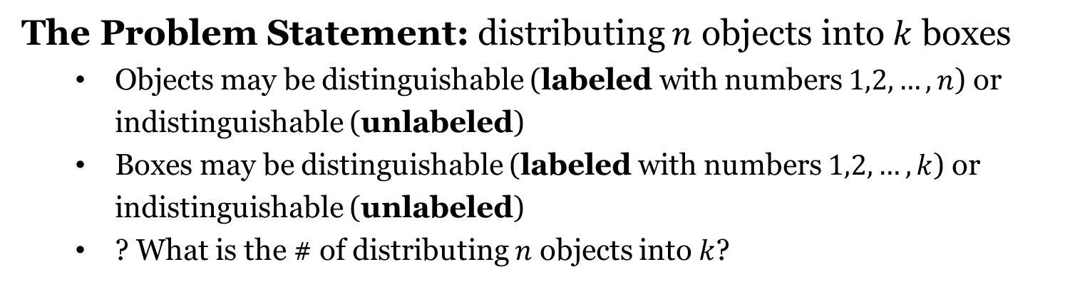
Distributing Objects into Boxes
The Problem Statement: distributing $n$ objects into $k$ boxes
Objects may be distinguishable (labeled with numbers $1,2,…,n$) or indistinguishable (unlabeled)
Boxes may be distinguishable (labeled with numbers $1,2,…,k$) or indistinguishable (unlabeled)
? What is the # of distributing $n$ objects into $k$?
Problem Type | Objects | Boxes
1 | labeled | labeled
2 | unlabeled | labeled
3 | labeled | unlabeled
4 | unlabeled | unlabeled
Problem Classification

Slide 13


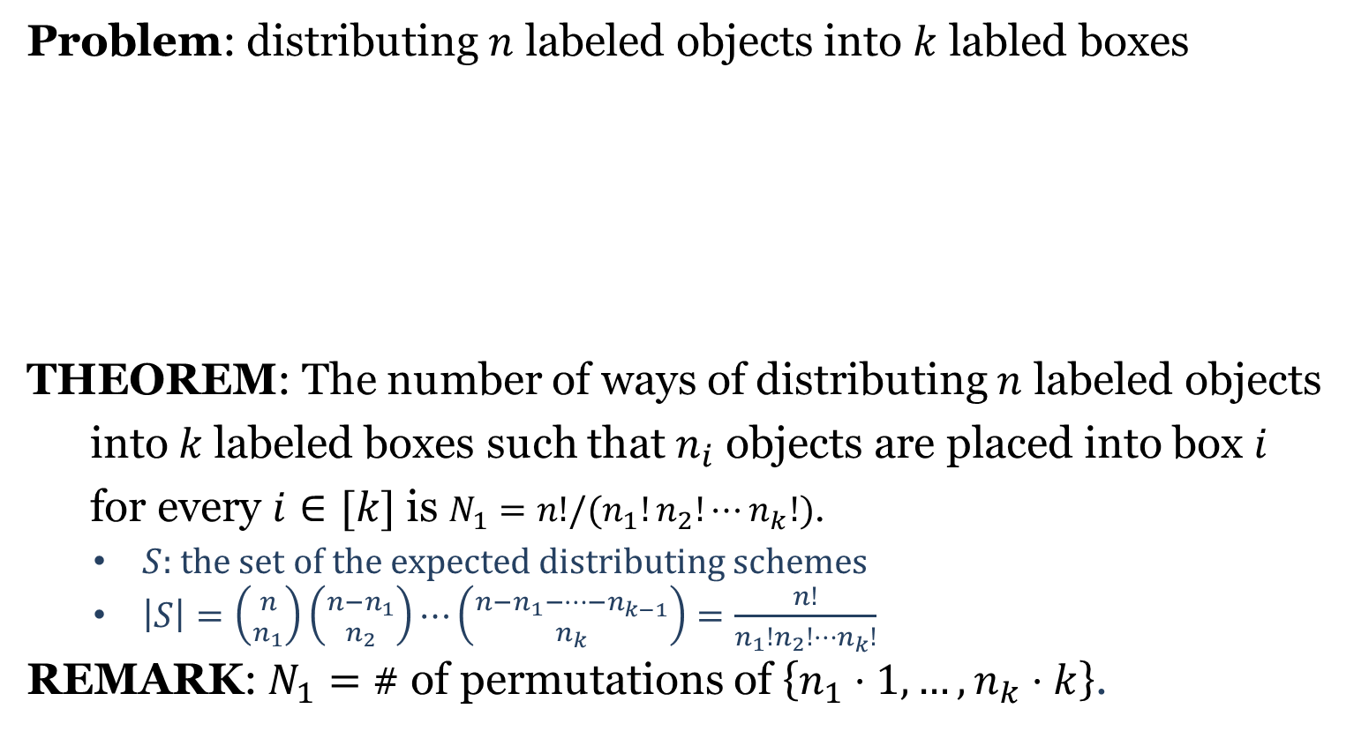









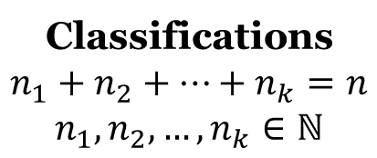
Type 1
Problem: distributing $n$ labeled objects into $k$ labled boxes
THEOREM: The number of ways of distributing $n$ labeled objects
into$k$labeled boxes such that $n_{i}$ objects are placed into box $i$
for every $i∈[k]$ is $N_{1}=n!/(n_{1}!n_{2}!⋯n_{k}!)$.
$S$: the set of the expected distributing schemes
$\left|S\right|=\left({n \atop n_{1}}\right)\left({n−n_{1} \atop n_{2}}\right)⋯\left({n−n_{1}−⋯−n_{k−1} \atop n_{k}}\right)=\frac{n!}{n_{1}!n_{2}!⋯n_{k}!}$
REMARK: $N_{1}=$ # of permutations of $\left\{n_{1}⋅1,…,n_{k}⋅k\right\}$.
$$1$$
$$2$$
$$⋯⋯$$
$$n$$
Classifications
$$n_{1}+n_{2}+⋯+n_{k}=n$$
$$n_{1},n_{2},…,n_{k}∈ℕ$$
$$1$$
$$2$$
$$⋯⋯$$
$$k$$
$$n_{1}$$
$$n_{2}$$
$$n_{k}$$

Slide 14


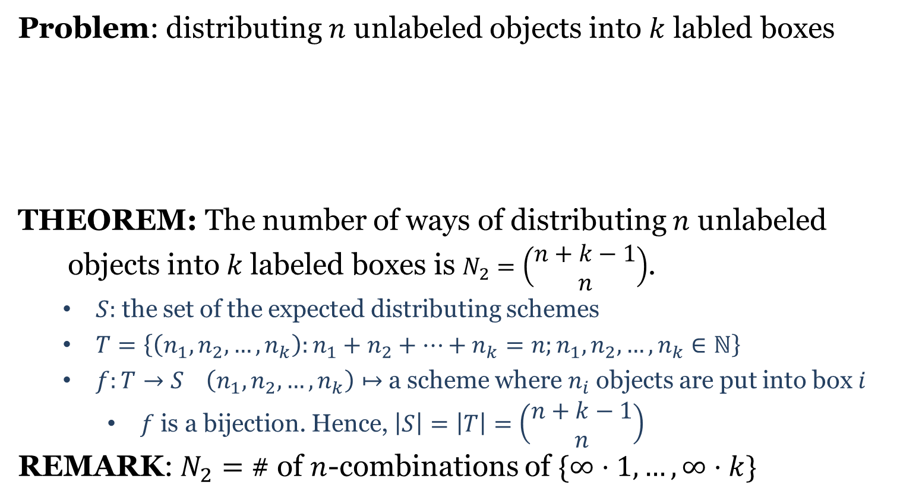








Type 2
Problem: distributing $n$ unlabeled objects into $k$ labled boxes
THEOREM: The number of ways of distributing $n$ unlabeled
objects into$k$labeled boxes is $N_{2}=\left(\begin{aligned}n+k−1 \\ n\end{aligned}\right)$.
$S:$ the set of the expected distributing schemes
$T=\left\{\left(n_{1},n_{2},…,n_{k}\right):n_{1}+n_{2}+⋯+n_{k}=n;n_{1},n_{2},…,n_{k}∈ℕ\right\}$
$f:T→S \left(n_{1},n_{2},…,n_{k}\right)↦$a scheme where $n_{i}$ objects are put into box $i$
$f$ is a bijection. Hence, $\left|S\right|=\left|T\right|=\left(\begin{aligned}n+k−1 \\ n\end{aligned}\right)$
REMARK: $N_{2}=$ # of $n$-combinations of $\{∞⋅1,…,∞⋅k\}$
$$⋯⋯$$
Classifications
$$n_{1}+n_{2}+⋯+n_{k}=n$$
$$n_{1},n_{2},…,n_{k}∈ℕ$$
$$1$$
$$2$$
$$⋯⋯$$
$$k$$
$$n_{1}$$
$$n_{2}$$
$$n_{k}$$

Slide 15

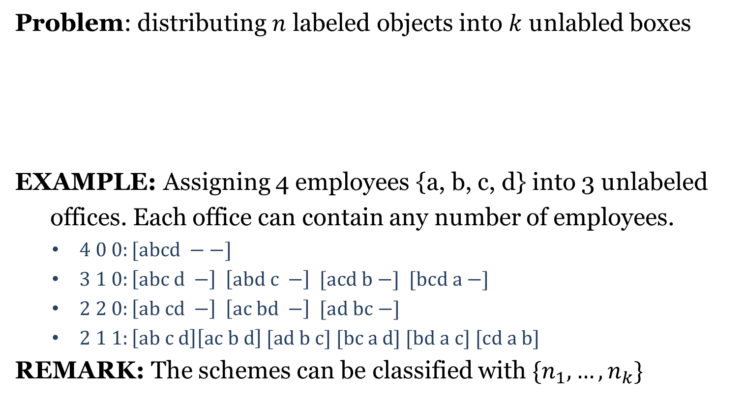



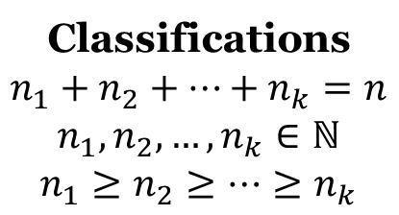




Type 3
Problem: distributing $n$ labeled objects into $k$ unlabled boxes
EXAMPLE: Assigning 4 employees {a, b, c, d} into 3 unlabeled
offices. Each office can contain any number of employees.
$4 0 0:[abcd −−]$
$3 1 0:\left[abc d −\right] \left[abd c −\right] [acd b −] [bcd a −]$
$2 2 0:\left[ab cd −\right] \left[ac bd −\right] [ad bc −]$
$2 1 1:\left[ab c d\right]\left[ac b d\right] [ad b c] [bc a d] [bd a c] [cd a b]$
REMARK: The schemes can be classified with $\{n_{1},…,n_{k}\}$
$$1$$
$$2$$
$$⋯⋯$$
$$n$$
Classifications
$$n_{1}+n_{2}+⋯+n_{k}=n$$
$$n_{1},n_{2},…,n_{k}∈ℕ$$
$$n_{1}≥n_{2}≥⋯≥n_{k}$$
$$⋯⋯$$
$$n_{1}$$
$$n_{2}$$
$$n_{k}$$

Slide 16

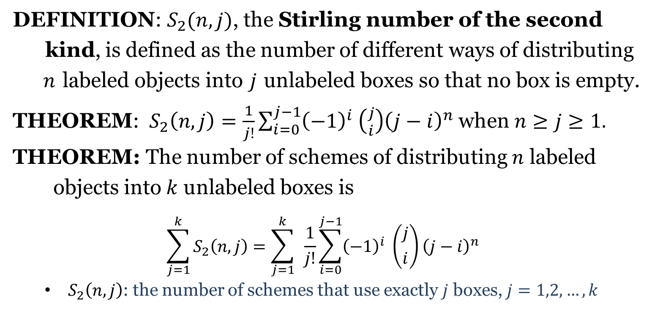
$$S_{2}(n,j)$$
DEFINITION: $S_{2}(n,j)$, the Stirling number of the second
kind, is defined as the number of different ways of distributing
$n$ labeled objects into$j$unlabeled boxes so that no box is empty.
THEOREM: $S_{2}\left(n,j\right)=\frac{1}{j!}\sum_{i=0}^{j−1}{{\left(−1\right)}^{i} \left({j \atop i}\right){\left(j−i\right)}^{n}}$ when $n≥j≥1.$
THEOREM: The number of schemes of distributing $n$ labeled
objects into$k$ unlabeled boxes is
$$\sum_{j=1}^{k}{S_{2}\left(n,j\right)=\sum_{j=1}^{k}{ }\frac{1}{j!}\sum_{i=0}^{j−1}{{\left(−1\right)}^{i} \left({j \atop i}\right){\left(j−i\right)}^{n}}}$$
$S_{2}\left(n,j\right)$: the number of schemes that use exactly $j$ boxes, $j=1,2,…,k$

